Slide 1
PRODUCT PRESENTATION
Pyro 7 Ultra
Professional Wireless Video Transmission
& Monitoring System
Model Pyro 7 Ultra
V1.0

Slide 2
SELLING POINTS
Ten Key Advantages
The Pyro 7 Ultra delivers professional-grade monitoring and transmission capabilities.
1
High Color Accuracy · Quantum Dot · 1500nits
2
4K60 UHD Transmission
3
One-to-Twenty Multi-Person Monitoring
4
Low Latency Focus Pulling Guarantee
5
Stable 1km Transmission Range
6
Intuitive UI System
7
HDMI IN/LOOP + SDI IN/LOOP
8
Versatile Power Options
9
Industry Ecosystem Connectivity
10
Pyro Ecosystem

Slide 3
OVERVIEW
Product Interfaces & Design
Inputs
Outputs
Other
HDMI IN
HDMI OUT/LOOP
Display
HDMI 2.0, up to 4K60
Up to 4K60
7.02" touch, 1920×1200
SDI IN
SDI OUT/LOOP
Antenna
3G-SDI, up to 1080P60
Up to 1080P60
4× SMA quick-release
DC IN
Audio
Battery
10–28V power input
3.5mm headphone jack
V-mount plate
SD Card
Up to 2TB
USB
Type-C (OTG)

Slide 4
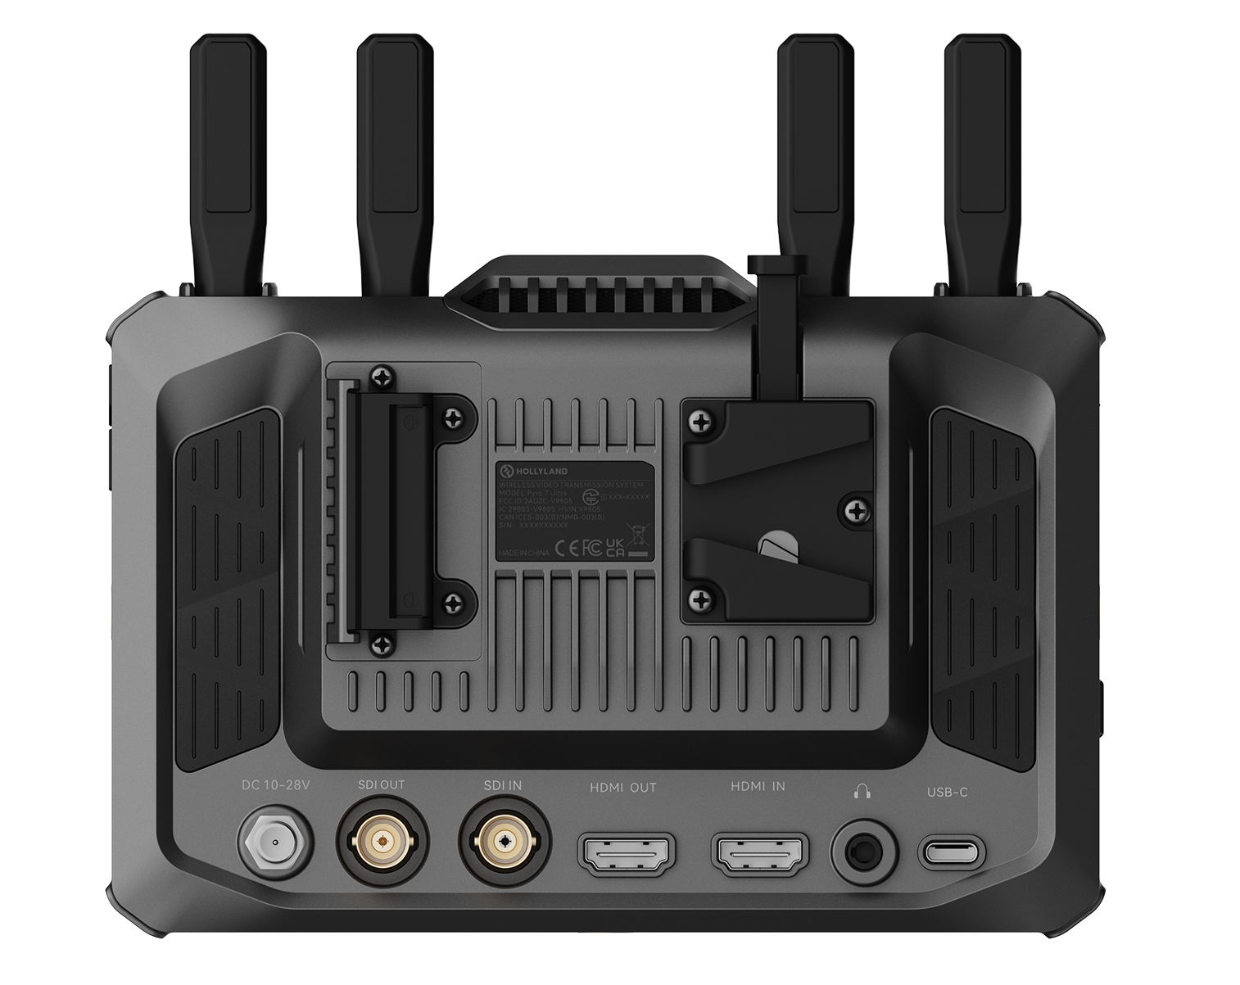
OVERVIEW
HDMI
Input
HDMI 2.0, up to 4K60
LOOP-OUT
HDMI 2.0, up to 4K60
Output (RX)
HDMI 2.0, up to 4K60
SDI
Input
3G-SDI, up to 1080P60
LOOP-OUT
3G-SDI, up to 1080P60
Output (RX)
3G-SDI, up to 1080P60
Notes:
Multiple device interfaces can cross-output, compatible with various professional shooting scenarios.

Slide 5
OVERVIEW
DC Input
10–28V
V-Mount Battery
12.8–16.8V
Power Consumption
≤ 25W (TX)
Integrates a built-in V-mount plate and a DC input to support both extended studio sessions and portable shooting.

Slide 6
MONITOR
As a Pure Monitor
Input HDMI or SDI signal directly and use the Pyro 7 Ultra as a professional-grade on-camera or studio monitor.
Waveform
Vectorscope
Histogram
Monitor exposure levels
Check color accuracy
View tonal distribution
False Color
Focus Peaking
Zebra
Quick exposure grading
Sharp focus confirmation
Exposure warning tool
3D LUT
Anamorphic De-Squeeze
Import custom .cube LUTs
1.33x / 1.5x / 2.0x

Slide 7
MONITOR
High Color Accuracy
Quantum Dot Wide Color Gamut · 1500nits High Brightness
Individually calibrated with Calman (Rec.709, Gamma 2.4, ΔE < 1.5) and enhanced by a Quantum Dot (QD) film, the Pyro 7 Ultra delivers a wide color gamut and an ultra-refined monitoring experience.
Brightness
Color Gamut
ΔE
Contrast
1500 nits
REC.709 ≥ 99%
DCI-P3 ≥ 95%
≤ 1.5
1000:1
Optional integrated tool-free sunshade. Supported by our proprietary monitor calibrator.
Notes:
DJI Monitor / SmallHD Indie7 / 致迅M7 Pro：ΔE≈2。
极影7 Ultra：实现ΔE<1.5的一体化无线监视器，省去返厂校色+监视器分层投入。

Slide 8
MONITOR
4K60 UHD Transmission
Delivers ultra-smooth, lossless image quality, perfectly tailored for high-end film production and demanding monitoring environments.
HDMI Input
Max Resolution
Loop-Out
HDMI 2.0
4K 60fps
HDMI 2.0 + 3G-SDI

Slide 9
MONITOR
Intuitive UI System
Features a logical interaction design with direct functional access for seamless and efficient professional monitoring.
Template
Video Auxiliary Analyze
Swipe left/right to switch function templates
Swipe up from bottom to summon and manage templates
Display Settings
Custom Shortcuts
Swipe down from top to adjust display parameters
Assign functions to F1/F2 physical shortcut keys
Touch Zoom
Video Playback
Two-finger touch supports 1–4X zoom
Supports video bookmarking, segmentation, pausing, and etc.

Slide 10

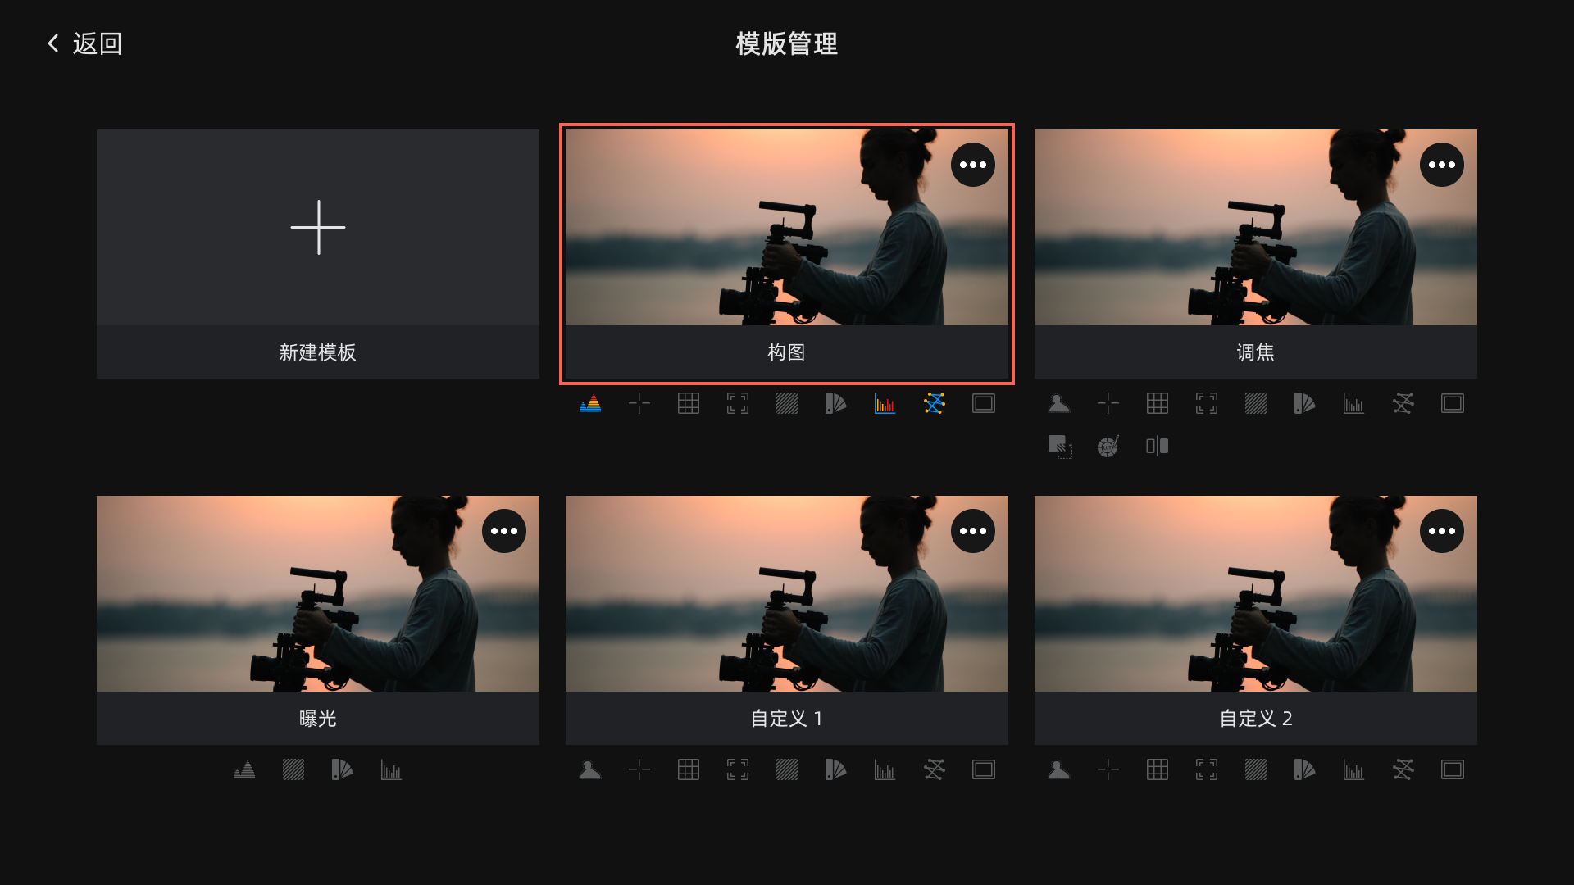
MONITOR
Interaction Architecture: Three-Tier Entry Design
Swipe up from the bottom: Access the template management page. It supports a total of 7 template sets (Custom, Exposure, Focus, and Composition), and image analysis options within each template can be freely added or removed.
New Template
Custom
Exposure
Swipe down from the top: Zone-based triggering of four major settings interfaces—Display Settings, Feature Settings, System Settings, and Device Information.
Focus Adjustment
Composition
Custom2
Swipe left or right: Quickly switch between functional modules for seamless transitions between monitoring scenarios.

Slide 11
MONITOR
Exposure: waveform, zebra stripes, false color
Focus: center marker, focus assist, sharpness
Composition: masking marker, safety frame, center marker, grid marker
PS: 1. The maximum number of templates is 7. In addition to the 4 templates included by default,3 more templates can be created (template naming is supported);
2. Each template supports adding/removing image analysis options.
New Template
Custom
Exposure
Focus Adjustment
Composition
Custom2

Slide 12
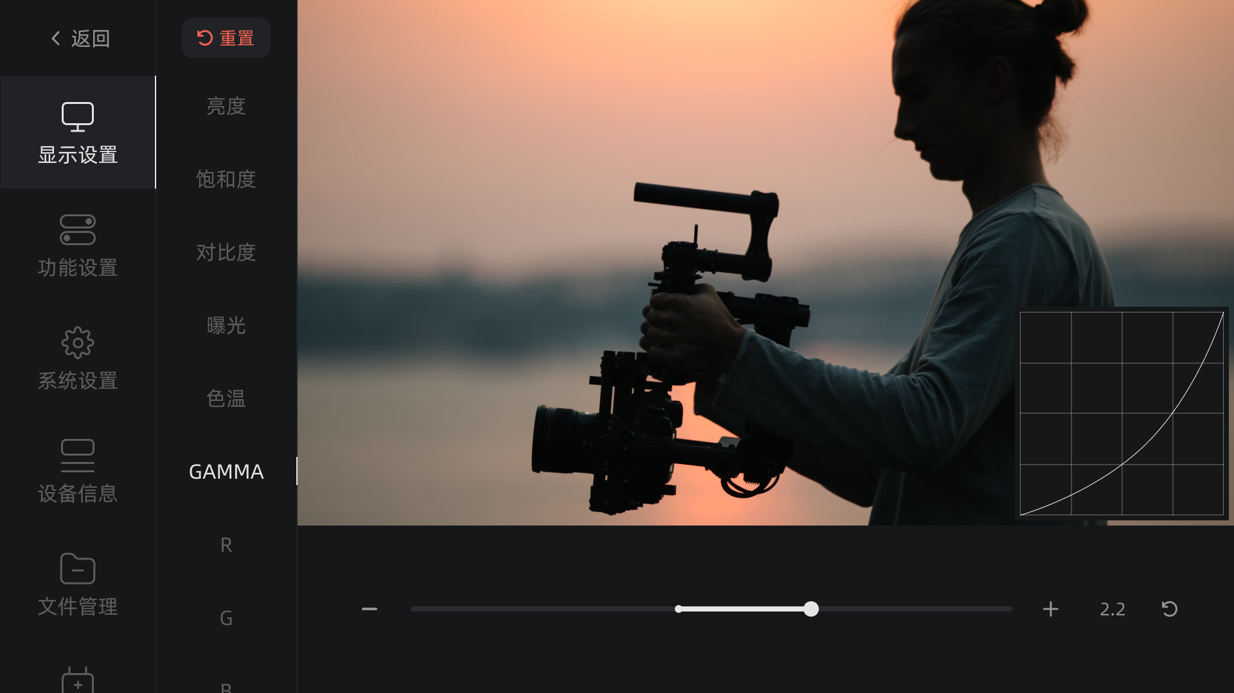
MONITOR
Display Settings: Based on factory calibration parameters, adjustments are made to brightness, saturation, contrast, exposure, color temperature, calibration, color space, Gamma, R, G, B, etc., to achieve differentiated display effects and meet the needs of various scenarios.
PS: Gamma is the brightness correction curve, used to match the human eye, compress storage, and monitor video; professional color grading 2.4. Adopts CIE1976 Lab* (CIELAB) color space.
Rec.709: Color standard for high-definition television and online video.
DCI-P3: Color standard for digital cinema.

Slide 13
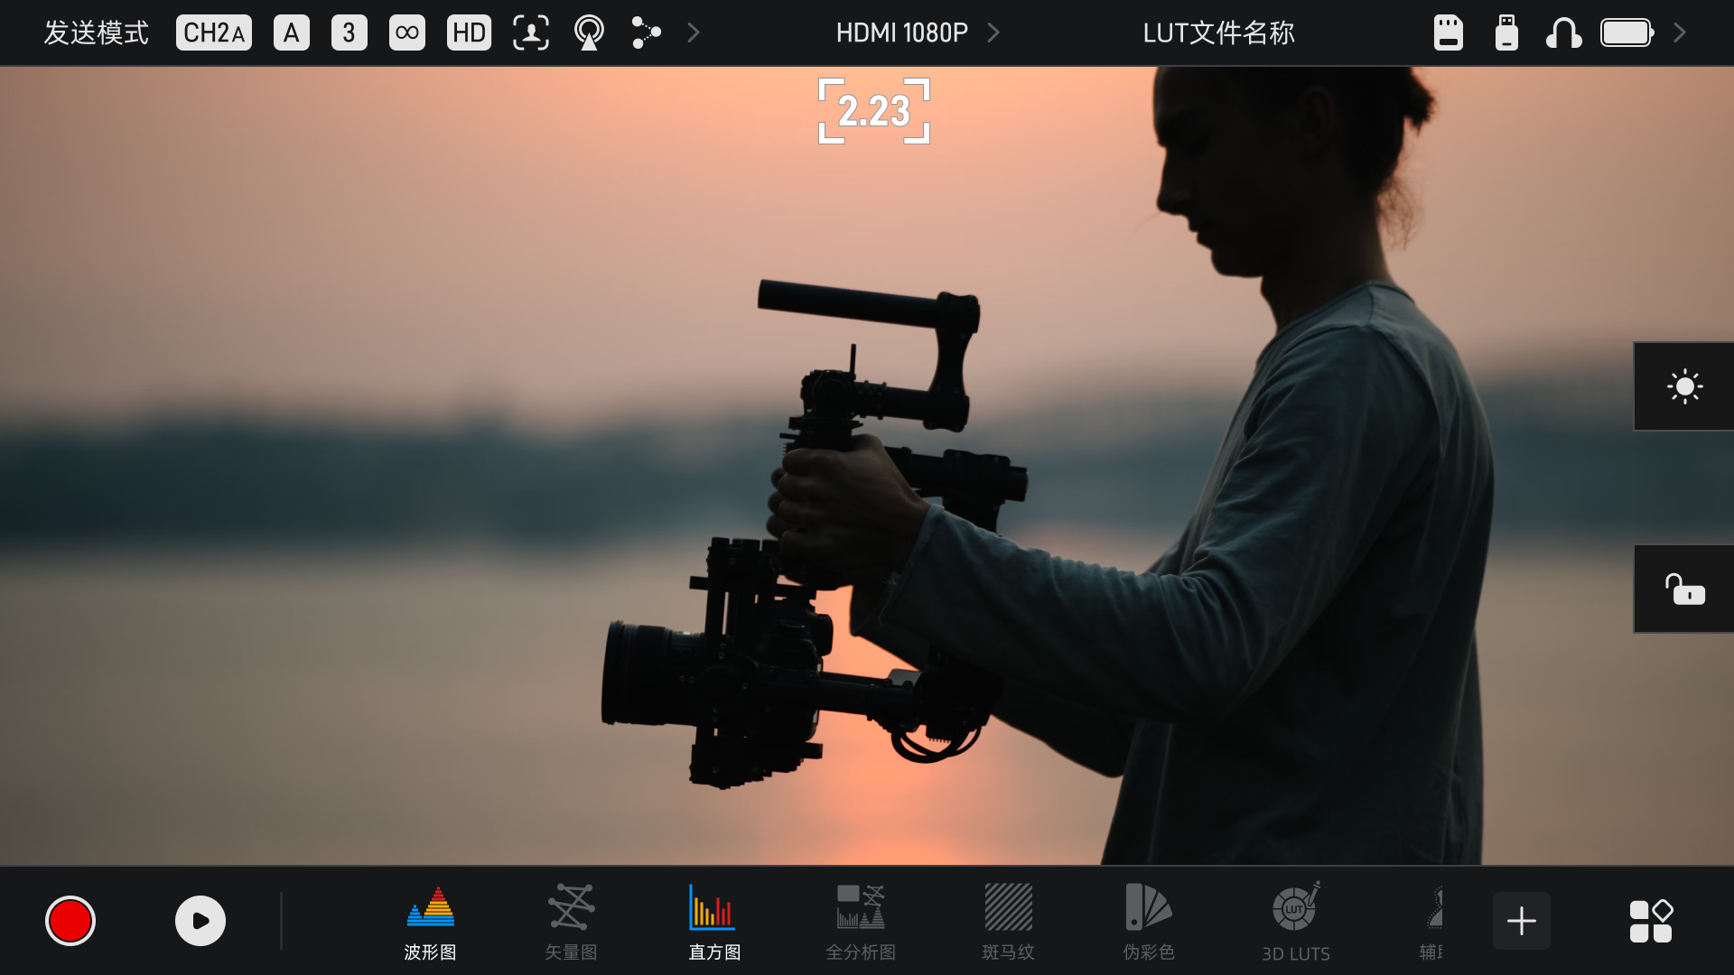
MONITOR
Stepless Zoom: Touch the corresponding area on the screen with two fingers to zoom in; supports 1x–4x touch-controlled zooming.

Slide 14
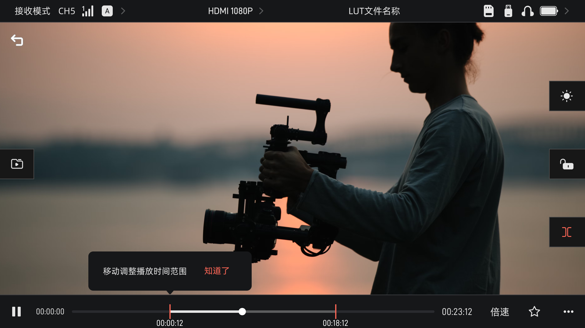
MONITOR
Video Playback: Supports features such as video bookmarking, segmentation, variable playback speeds (0.25x, 0.5x, 1x, 1.25x, 1.5x, 2x, 3x), pausing, additional settings (looping, reverse playback), and episode selection.

Slide 15
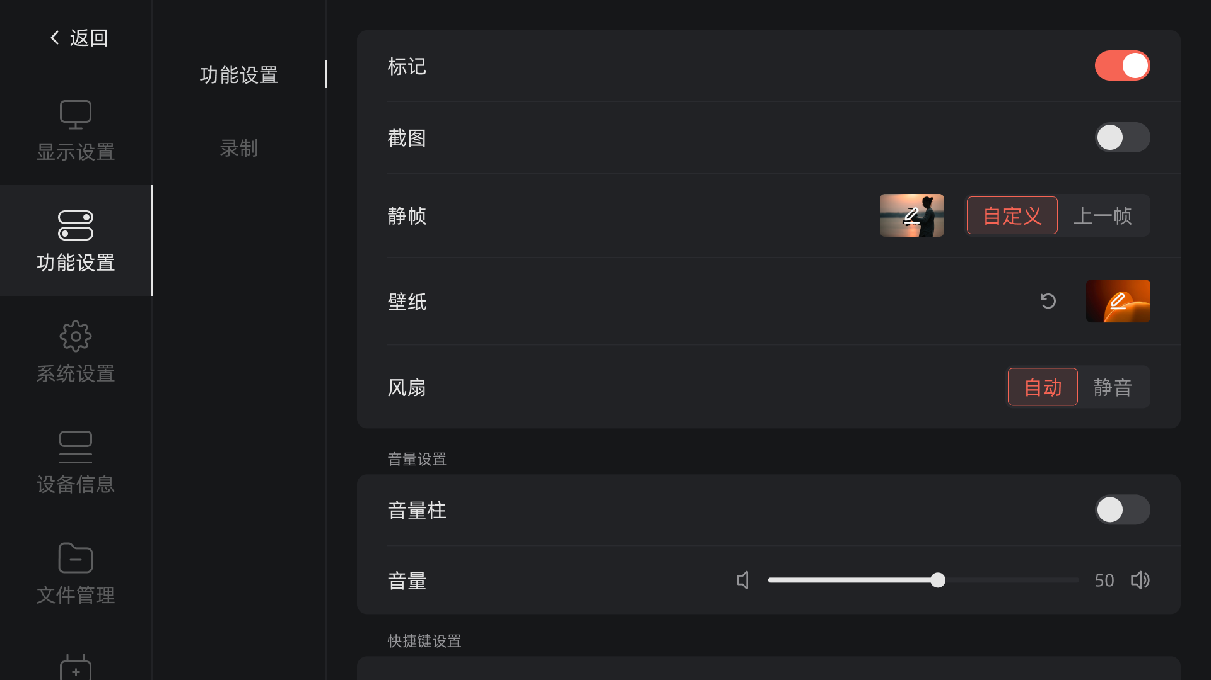
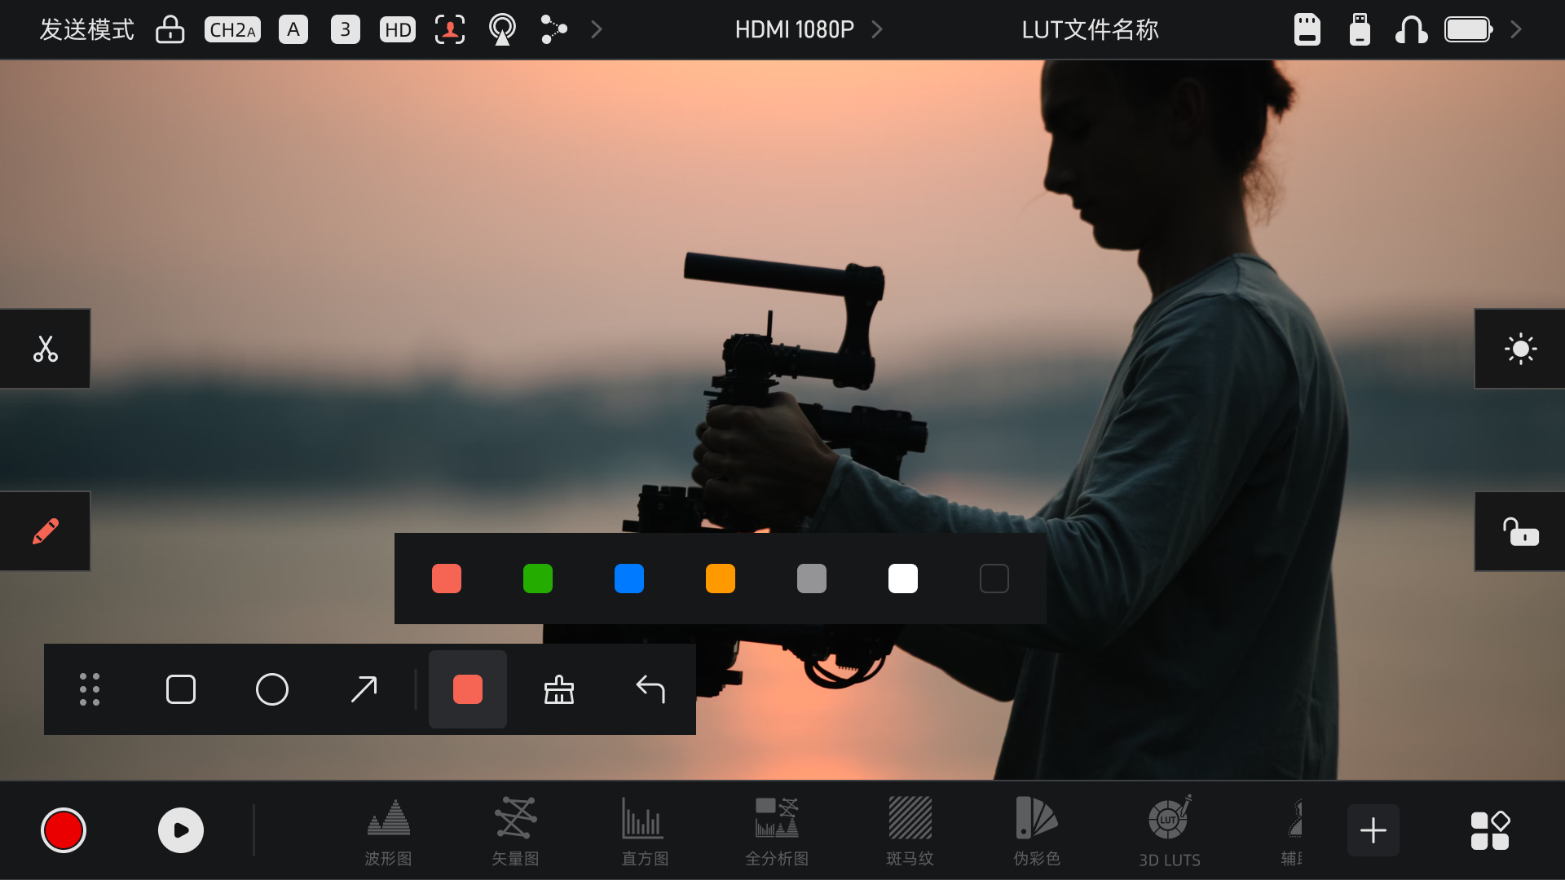
MONITOR
Marker: A marker button is displayed on the homepage when enabled. When any monitor in the same group activates the marker, all other devices in the group will synchronously display the marker status. (both transmit and receive modes are supported).
Screenshot: A screenshot button is displayed on the homepage when enabled.
Freeze Frame: Provides two display modes for signal interruption:
Custom: A custom image can be imported via USB flash drive or SD card. This image is automatically displayed when the signal is interrupted.
Previous Frame: Retains the last frame displayed before the signal interruption.
Wallpaper: Supports importing custom images via USB flash drive or SD card and setting them as the device wallpaper.
PS: Supported formats for custom still frame images and custom wallpaper images are jpg/png. There is no size limit for the images.

Slide 16
VIEWO TRANSMISSION
Video Transmission System
With TX/RX combination, the Pyro 7 Ultra functions as a powerful wireless video transmission system.
01
02
03
Multi-View
Low Latency
Long Transmission Range
Connect transmitter to camera via HDMI/SDI
1km stable 2.4G/5G transmission
Up to 20 receivers in broadcast mode

Slide 17
VIEWO TRANSMISSION
One-to-Twenty
Multi-Person Monitoring
One-transmitter–twenty-receiver architecture, supporting multi-device synchronous monitoring — eliminating the need for multiple people to crowd around the same monitor, improving on-set collaboration efficiency.
Unicast Mode
Broadcast Mode
Compatible Series
1-to-4 + APP×2
1-to-20
Pyro Ultra · Pyro 5 series Pyro 7 · Pyro S

Slide 18
VIEWO TRANSMISSION
Low Latency Focus Pulling
20ms
Professionally verified through Pyro Ultra, precisely matching professional scenarios with extremely high real-time requirements such as focus Mode.
ultra-low latency

Slide 19
VIEWO TRANSMISSION
Stable 1km Transmission Range
Achieves a stable 1km transmission range, effortlessly covering extreme shooting environments such as outdoor locations and aerial cinematography.
Frequency Band
Transmit Power
2.4G + 5G
< 24dBm

Slide 20
ECOSYSTEM
Industry Ecosystem Connectivity
Supports the Tilta focus ecosystems, enabling seamless device interconnection within professional industry workflows.
Camera control functions are compatible with Sony, Canon, Nikon, and other cameras.

Slide 21
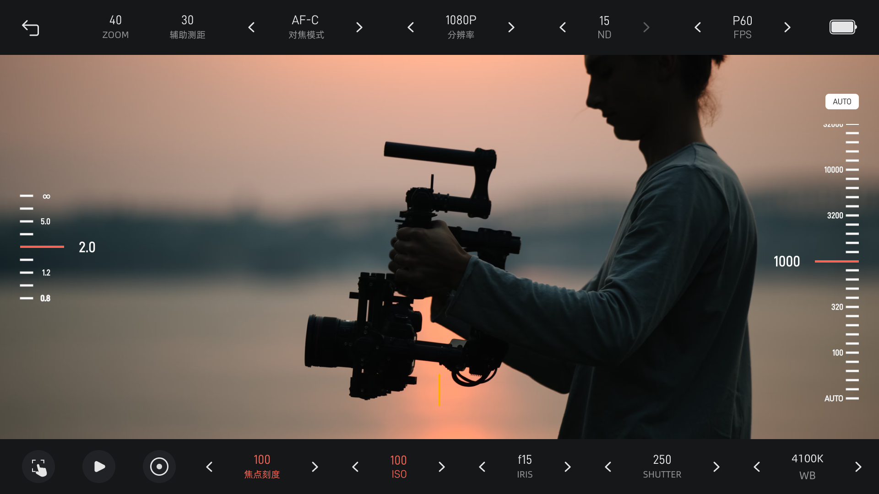
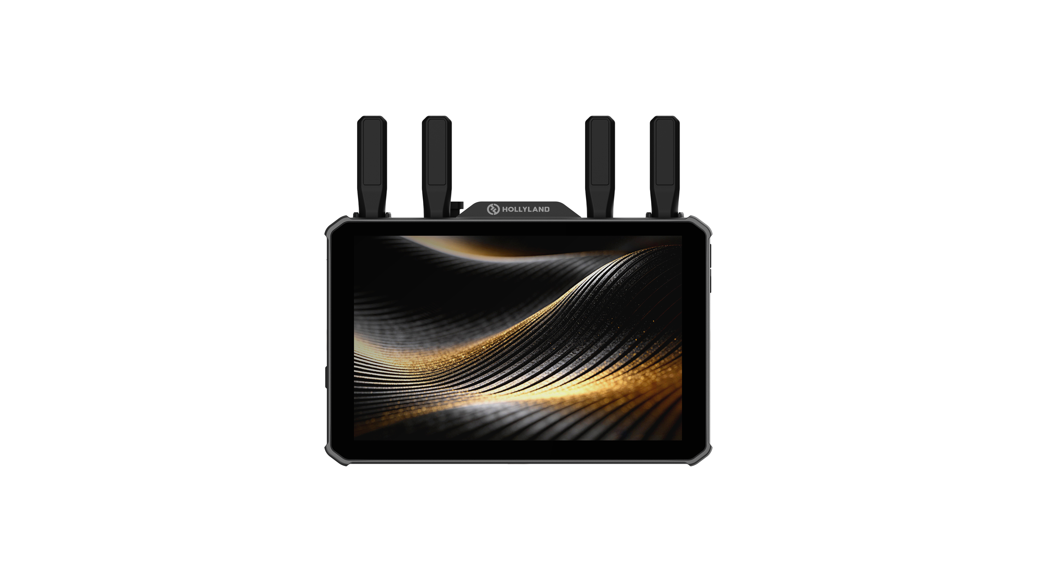
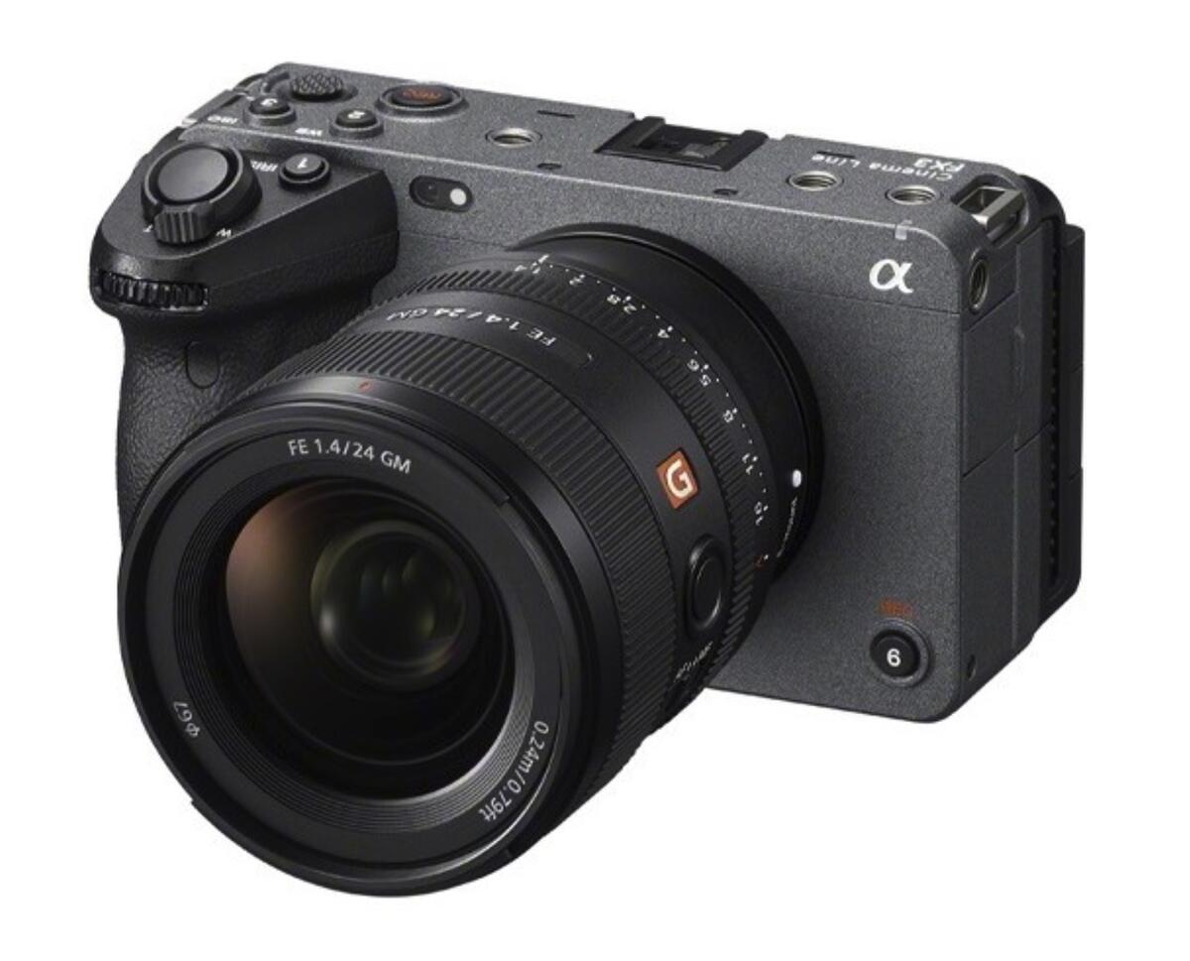
索尼/佳能/尼康等相机控制
ECOSYSTEM
1. Camera Connection
Method 1: (Connect the USB cable first, then configure settings)
① Plug one end of the USB cable into the Sony camera's USB port and the other end into the transmitter's USB port.
② Pop-up window: Select USB connection mode => Select Remote Shooting (PC Remote).
Method 2: (Configure settings first, then connect the USB cable)
① Open the Sony camera menu, navigate to "Network" => PC Remote Function => Enable PC Remote.
② Plug one end of the USB cable into the Sony camera's USB port and the other end into the transmitter's USB port.
2. Swipe left to access the camera control panel (see image on the right).
HDMI
Type-C
TX
RX
Taking the FX3A as an example: The Pyro7 Ultra monitor (TX or RX) allows for on-screen control of camera parameter adjustments (focus mode, resolution, frame rate, touch focus, playback, recording, ISO, iris, and shutter).
Both TX and RX can enter camera control mode.

Slide 22
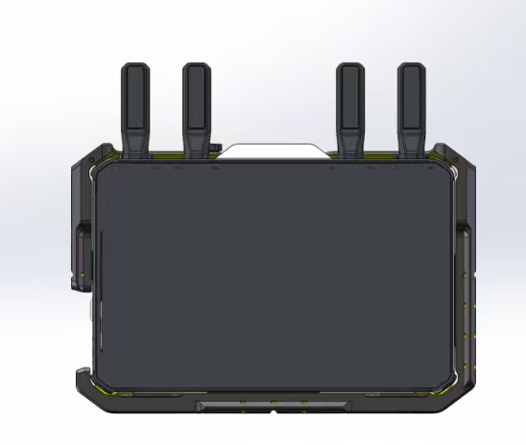
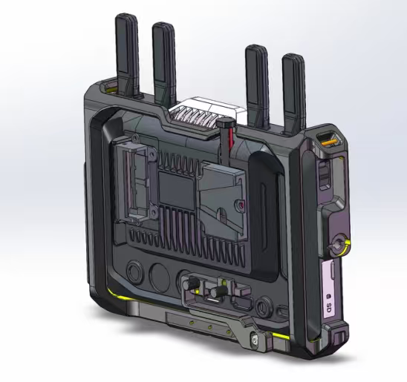
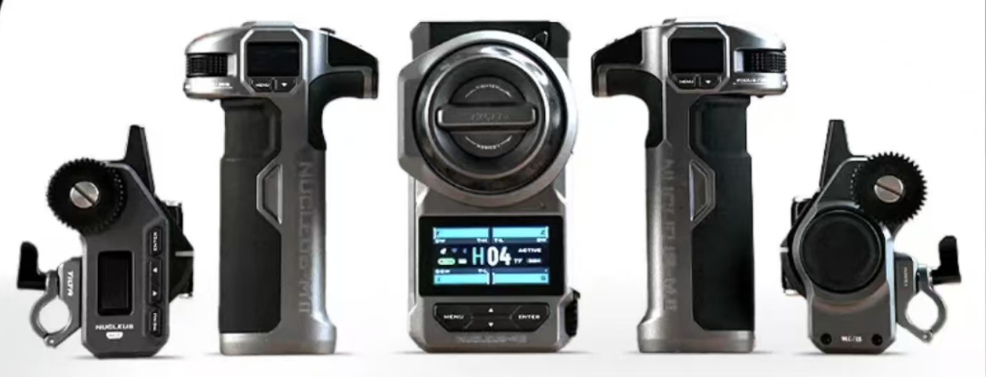
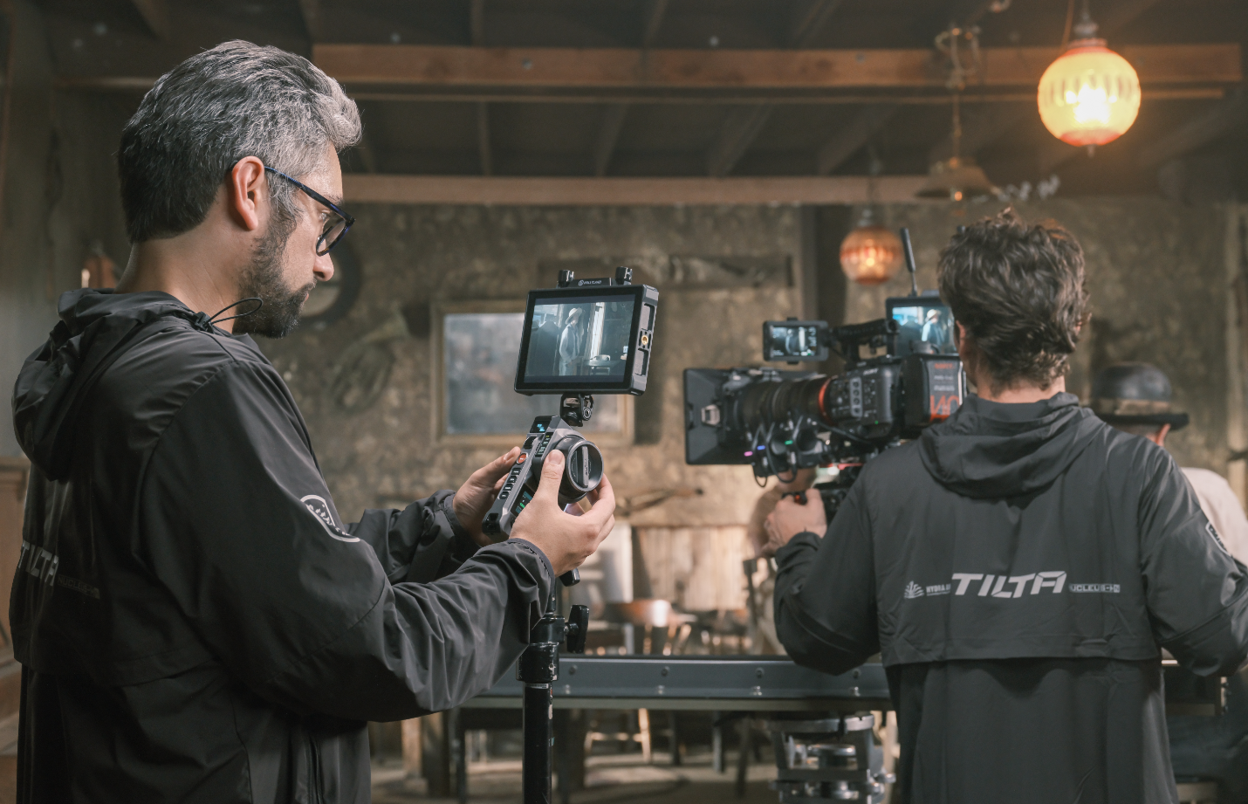
ECOSYSTEM
Pyro 7 Ultra paired with the Tilta Nucleus M2 follow focus system for focus, iris, and zoom control, along with a custom cage for the Pyro 7 Ultra.
Connection: In receiver mode, the Pyro 7 Ultra connects to the Nucleus M2 hand unit via dual Type-C cables.

Slide 23
ECOSYSTEM
Pyro Ecosystem
Enables seamless interconnection across the Pyro series, providing a cost-efficient and flexible setup for diverse shooting environments.
Pyro Ultra
Pyro 5
Pyro 7
Pyro 5 4k
Pyro S

Slide 24
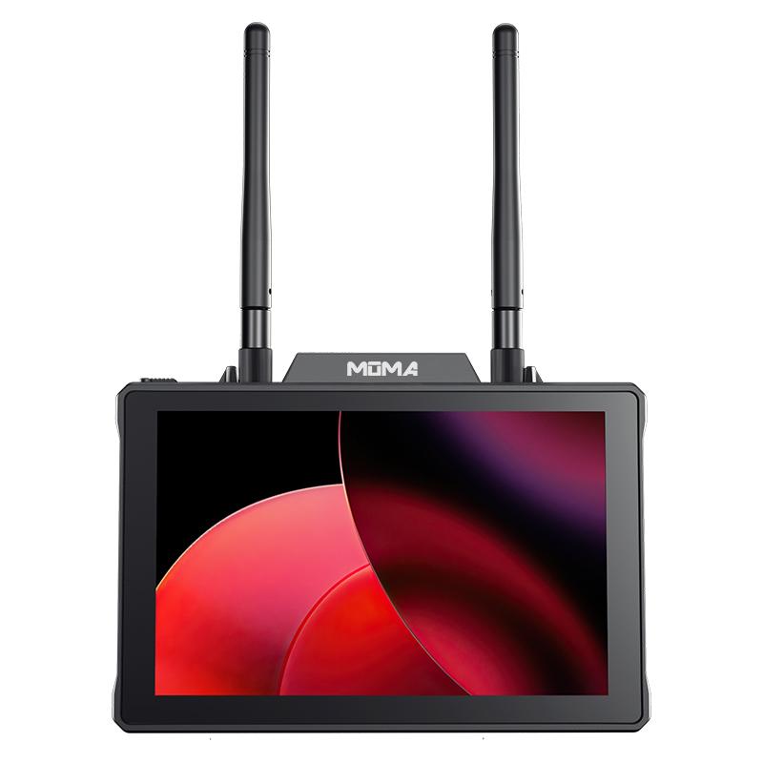
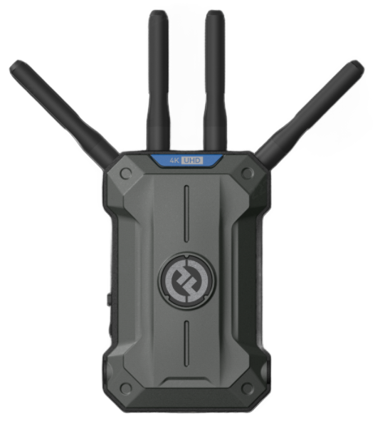
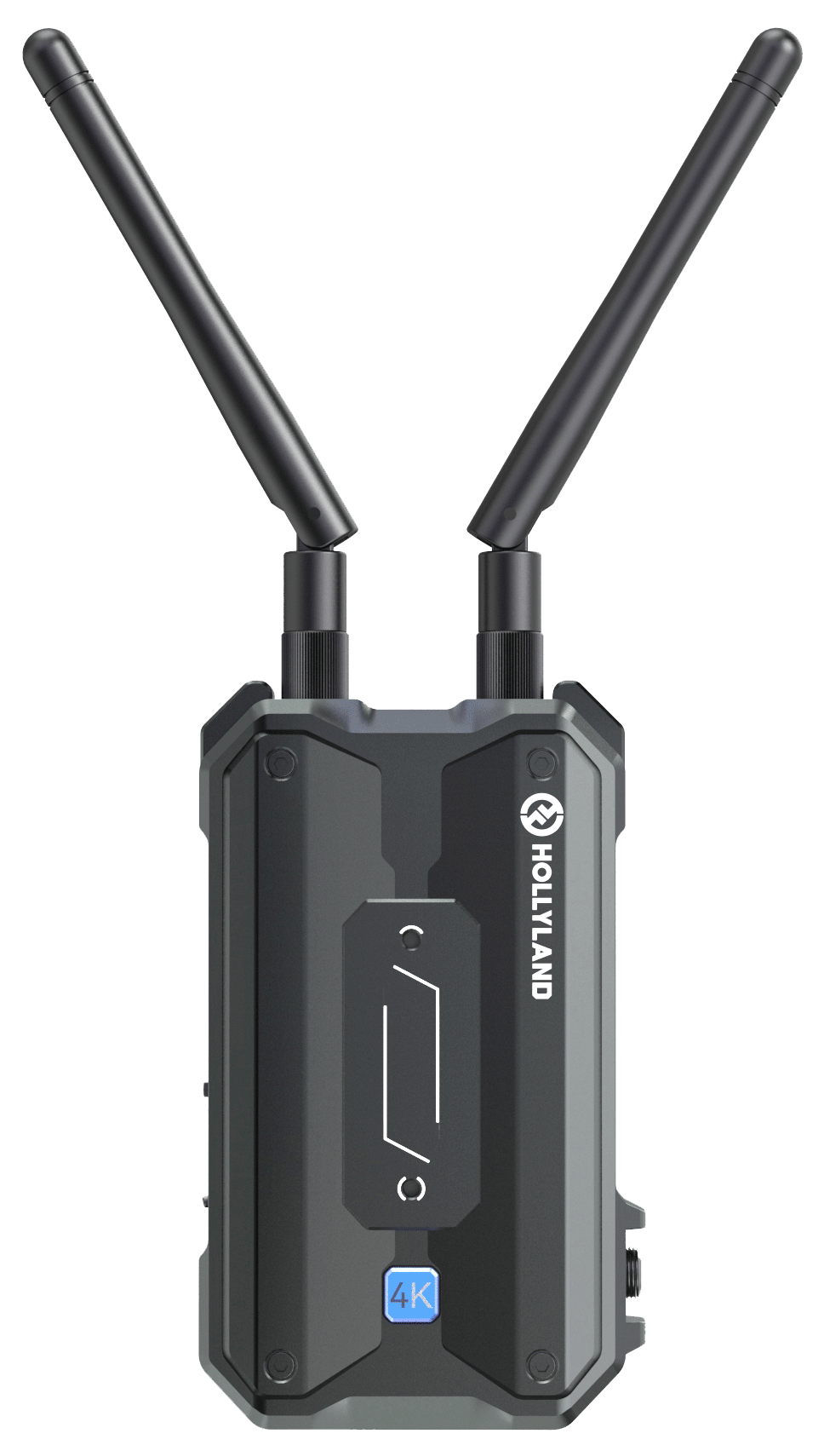
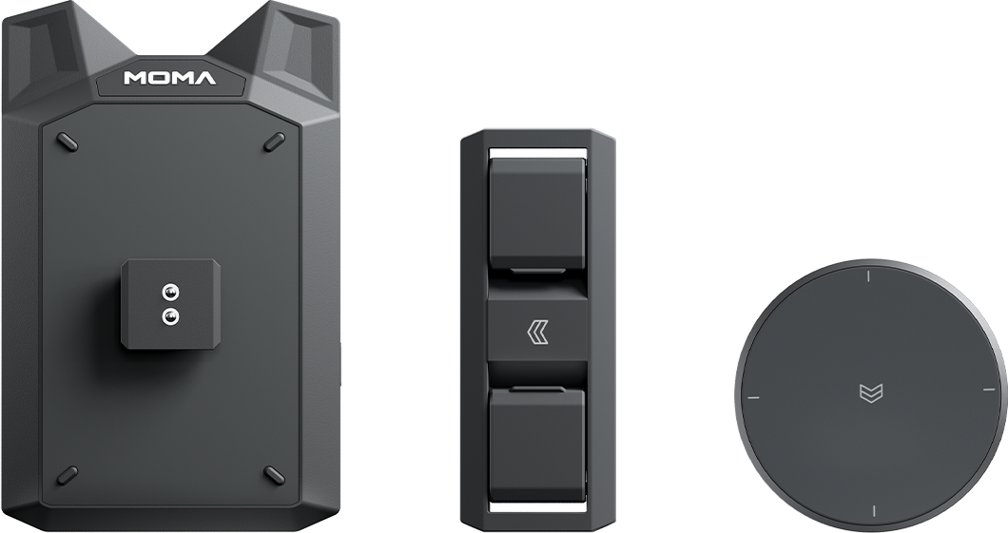
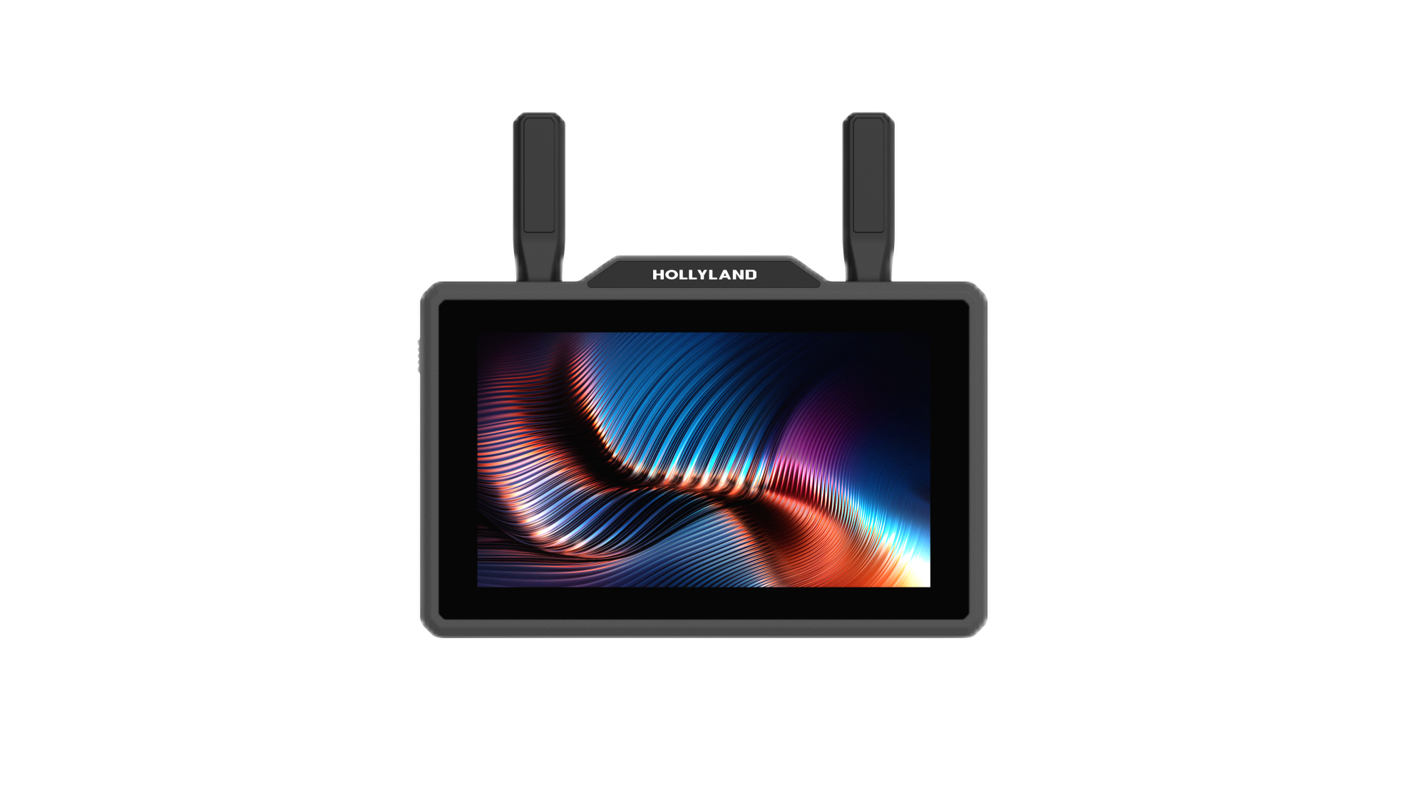
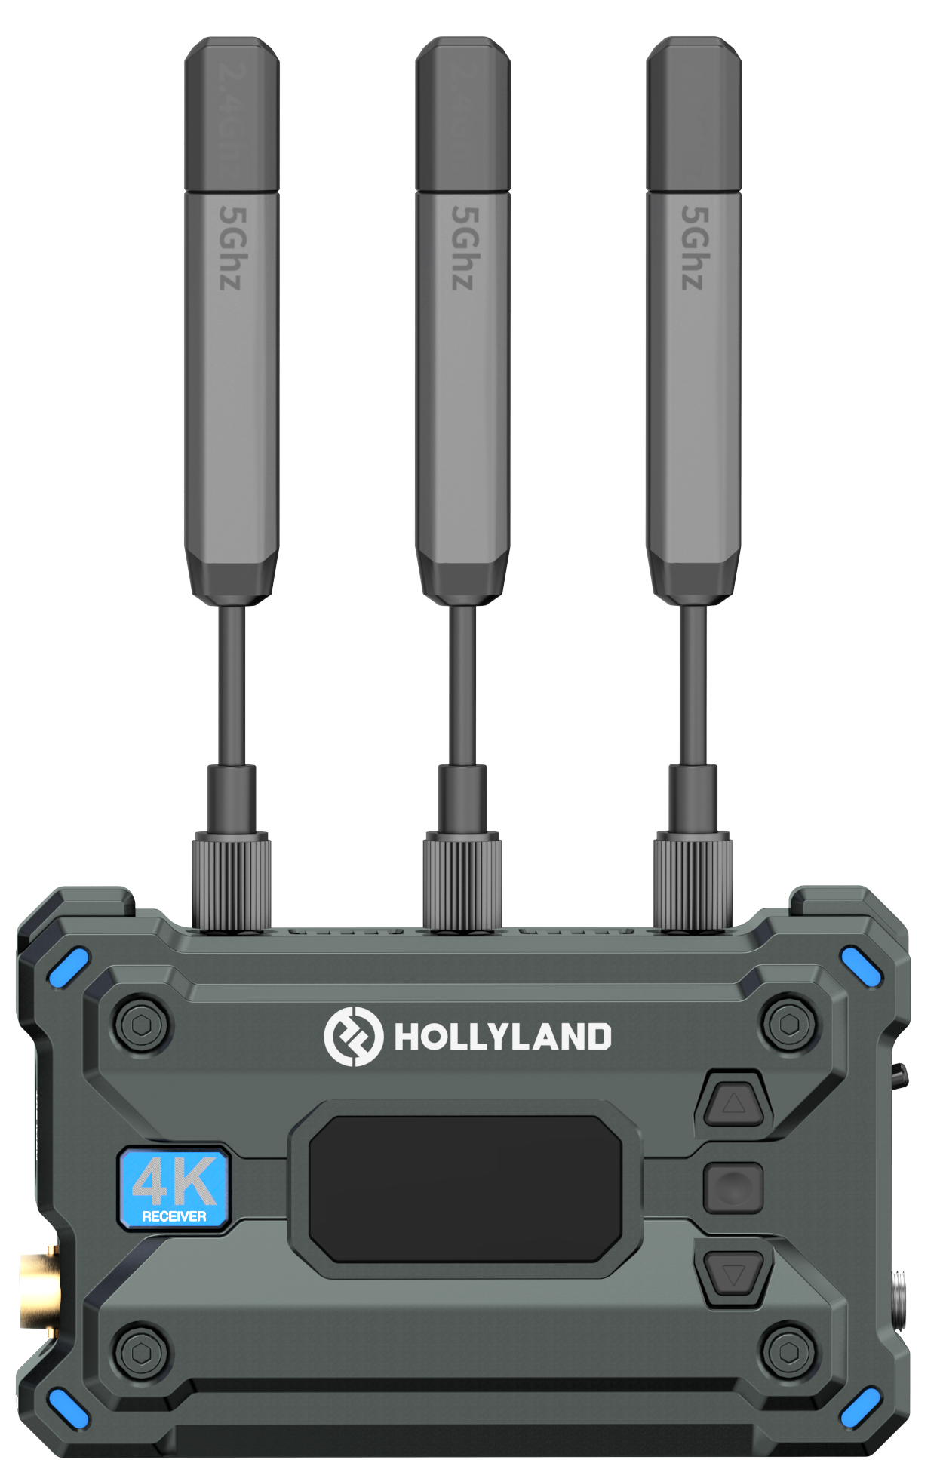
ECOSYSTEM
The Pyro 7 Ultra is compatible with any model in the Pyro ecosystem, allowing for flexible and diverse combinations to build a comprehensive Pyro ecosystem matrix.
PS: When used with Vcore, it functions only as a receiver; when used with Pyro H, it only supports unicast mode, and Pyro H functions only as an RX.

Slide 25
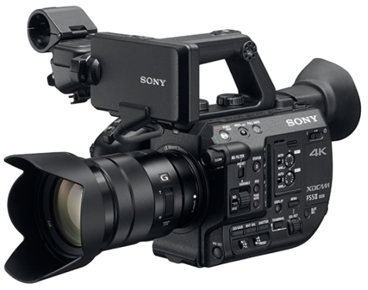


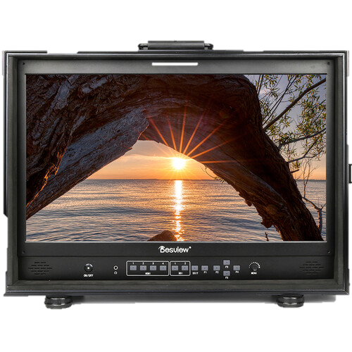
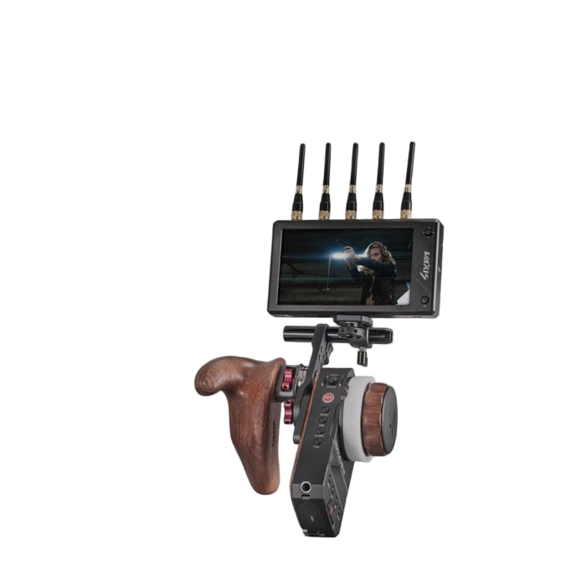
TVC Shooting
SDI
RX1
RX20
HDMI
SDI
....

Slide 26
SCENARIOS
Application Scenarios
TV Drama / Web Series
TVC Shooting
Wireless monitoring for multi-camera setups over long distances, providing key reference images to the director and cinematography team in real time, ensuring unified color and framing across all shots.
High-brightness outdoor monitoring with the 1500nit screen, color-accurate wireless transmission for review and approval, combined with a V-mount battery to support extended shooting sessions.

Slide 27
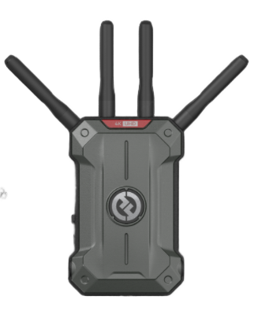

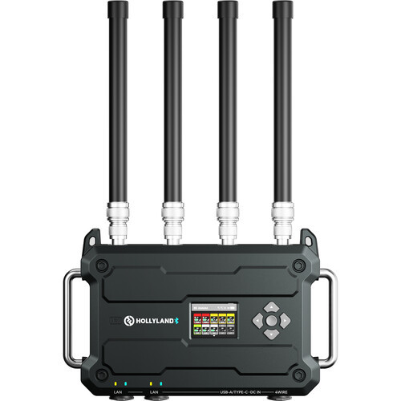
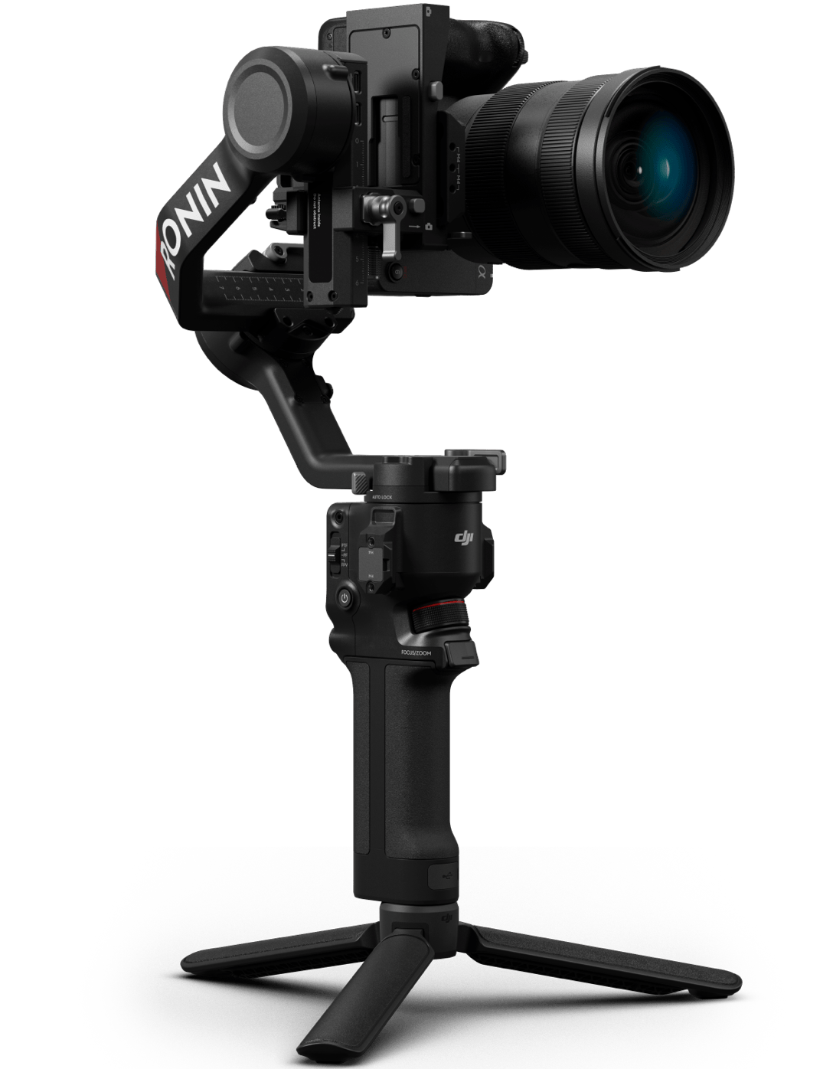
2.4G&5G无线频段
1.9G无线频段
HDMI/SDI连接
TV Series/Web series filming location
A机
B机
C机
A
Focusing
Party A
B
Lighting guidance
Director
log keeper
9806
C
Executive Director

Slide 28
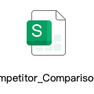
Product Mode |  |  | Pyro 7 | Pyro 7 Ultra | DJI Monitor | small hd indie7 | accsoon m7 pro | Accsoon 4k+shinobi7 | Accsoon 4K+PortkeysBM5Ⅳ | DJI SDR+shinobi7
Wireless | Wireless performance | DFS Frequency point | × | √ | √ | / | ×（illegal use） | × | × | √
 |  | Transmission format | HDMI：3840*2160p30 SDI：1080p60 | HDMI：3840*2160p60 SDI：1080p60 Supports converting i format to p format | HDMI：1080p60 SDI：1080p60 | / | HDMI：3840*2160p60 SDI：1080p60 Supports converting i format to p format | HDMI：3840*2160p60 SDI：1920*1080 Supports converting i format to p format | HDMI：3840*2160p60 SDI：1920*1080 Supports converting i format to p format | 1080P60 Doesnt support converting i format to p format
Wireless function | System Functions | Metadata transmission (Matching the monitor) | × | × | √ | √ | × | X | X | X
 |  | Trigger to start recording | √ | √ | √ | × | √ | × | × | √
Monitor performance indicators | Display specifications | Screen Brightness (Nominal) | 1500nit | 1500nit | 1500nit | 1000nit | 7/800nit | Peak 2200 nits | 2000nit | Peak 2200 nits
 |  | Screen Resolution | 1920*1080(1200) | 1920*1080(1200) | 1920*1200 | 1920*1200 | 1920*1080 | 1920*1200 | 1920*1080 | 1920*1200
 |  | Screen Contrast Ratio (Nominal) | 1000：1 | 1000：1 | 1000：1 | 1000：1 | 1000：1 | 1000：1 | 1000：1 | 1000：1
 |  | QD - Quantum Dot Transparent Film | × | √ | × | × | × | × | × | ×
 |  | HDR Display | × | × | × | × | × | Software simulation | Software simulation | ×
 |  | Screen Color Gamut | rec709--99% | rec709--99% dci p3--95% | Rec.709：≈98–100% DCI‑P3：≈85–90% | rec709--99% | rec709--99% | around rec709--99 | rec709--98~100% dci-p3--85% dci-d65--85% | around rec709--99
 |  | △E | ≤2 | ≤1.5 | About 2 | ≤2 | ≤2 | ≤2 | ≤2 | ≤2
 |  | Maximum Input Resolution | 3840*2160p30 | 3840*2160p60 | / | 3840*2160p30 | 3840*2160p60 | 3840*2160p60 | 3840*2160p60 | 1920*1080p60

Slide 29
Thanks for watching

